Slide 1
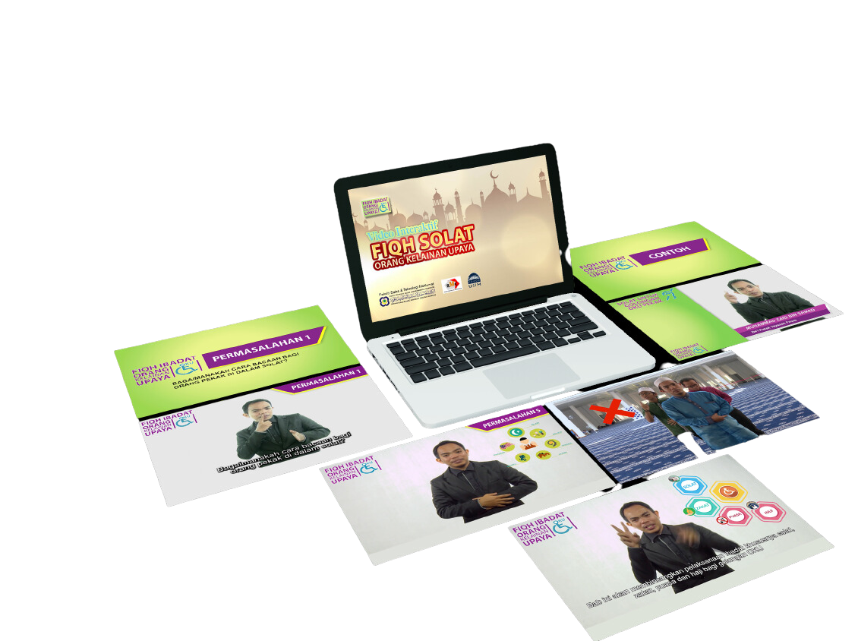



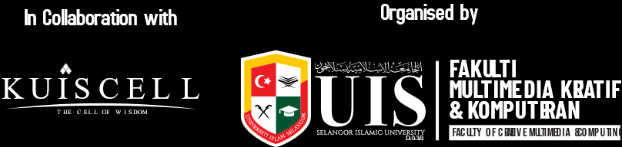
DEVELOPMENT OF OKU PRAYER FIQH INTERACTIVE VIDEO (DEAF AND MUTE)
INVENTORS DETAIL:
  1. Che Wan Shamsul Bahari Che Wan Ahmad
  Jabatan Sains Komputer Fakulti Multimedia Kreatif & Komputeran cwshamsull@uis.edu. my Hp : 013-2449985
  2. Muizz Salleh
Jabatan Multimedia Kreatif ,Fakulti Multimedia Kreatif
& Komputeran
muizz@uuis.edu. my Hp : 018-9899072
PRODUCT DESCRIPTION
IMPLEMENTATION LEVEL
There are 12 issues that have been selected related to the Fiqh of my prayers deaf and mute are included in this application and every explanation will be supported by re-enactment of facilitate understanding. In addition, the translation in Sign language is provided in each issue for provide understanding to the disabled and deaf and mute who use this application. Youtube used as the main platform of this application for make it easier for users to view videos to make it easier access without having to install a new application to the phone smartphone or laptop.
Analysis phase of the problem of people with disabilities in prayer.
Develop video content.
Develop interactive video application interface
Test the effectiveness of interaction video for instructor and respondent.
USES AND APPLICATIONS
This study is related to the development of an Interactive Video Application that touches on the Fiqh of Prayer for deaf and mute people. There are 12 issues that have been selected related to the Jurisprudence of deaf and dumb prayers included in this application and each explanation will be supported by reenactments to facilitate understanding. In addition, a translation in hand sign language is provided in each issue to provide understanding to the disabled.
INNOVATION OBJECTIVES
Identify the issues and problems of prayer in the circle OKU (Fiqh Solat OKU) deaf and mute.
Develop printed modules and Interactive Video applications for Disabled deaf and mute.
Evaluate and test the usability of this Interactive Video application for disabled deaf and mute
INNOVATION PRODUCT/
PROJECT IMPACT
PROBLEM STATEMENT
There is still no in-depth study related to issues and problems for the disabled related to prayer in Malaysia
Lack of teaching aids that are clear and interesting to provide understanding related to the Fiqh of prayer for the disabled.
Enhances Inclusive Islamic Education
The interactive video serves as an accessible learning tools for deaf and mute (OKU pendengaran dan bisu), providing equal opportunities to learn and practice fiqh solat accurately and confidently.
AUTHENTICITY/ NOVELTY
ACHIEVEMENTS
Providing an interactive video platform in the form of explanations and brief role-plays to provide understanding regarding issues that often occur in prayer matters for the disabled.
  Received an Innovation Grant from the Secretary of the Selangor State Government in conjunction with the launch of the Smart Selangor 2017 program of RM50,000.

